Slide 1

RabbitMQ – components, benefits and application
Authorship: Marc Cervera rosell
Josep lluís lérida – distributed computing
Bachelor’s degree in computer engineering – university of lleida
Notes:
The last thing we think about when we say "RabbitMQ" is in a messaging broker

Slide 2
Contents
Introduction
Architecture
AMQP
Exchange
Routing key
Queue
Binding
Virtual host
Applications
MQTT
STOMP
WebSockets
RabbitMQ streams
RabbitMQ in the market
Advantages
Disadvantages
Competition in the market
Conclusions
References

Slide 3
Introduction
The main aim of this investigation is to discover RabbitMQ.
There’re three main essential attributes when designing and developing software to offer a trustworthy product: scalability, resiliency and interoperability.
RabbitMQ complains each one of these attributes.
RabbitMQ is an open-source message broker, sometimes called message-oriented middleware.
“Advanced message queuing protocol” (AMQP) as the core architecture.
RabbitMQ is a cross-platform software and the code is released under the Mozilla public license.
Simple definition for RabbitMQ ➔ Defines queues that will store messages until a consumer app gets these messages and process it.
Notes:
attributes when designing and developing for providing trustworthy products => scalability, resiliency and interoperability.
RabbitMQ => open-source message broker that implements AMQP as the core architecture.
Is a cross-platform software and the code is released under the Mozilla license.

Slide 4
Architecture
RabbitMQ was implemented for supporting AMQP.
Extended by a plug-in architecture support ➔ STOMP, MQTT, HTTP, WebSockets and RabbitMQ streams.
HTTP is not actually a messaging protocol RabbitMQ can transmit messages over HTTP in three ways:
Using the web STOMP plug-in.
Using the MQTT plug-in.
Using the Management plug-in ➔ Supports a simple HTTP API to send and receive messages.
Notes:
Originally RabbitMQ was designed for supporting AMQP but it has been extended with a plug-in architecture support. => Apart from AMQP can support STOMP, MQTT, HTTP, WebSockets and Streams.
HTTP is not a messaging protocol but RabbitMQ can transmit messages over HTTP.
STOMP plug-in => Supports STOMP messaging to the browser using WebSockets.
MQTT plug-in => Same as the above one.
Management plug-in => Simple HTTP API for messaging

Slide 5
Architecture - AMQP
Is the core protocol supported by the broker.
AMQP is a binary protocol and defines quite string messaging semantics.
Reasonably simply to implement for clients.
AMQP stands out for his fidelity.
Used by big corporations that have to process million of messages.
Before AMQP were other message-oriented middleware, such is, JMS, but AMQP has become the standard one.
Notes:
Reasonably simply to implement for clients => There are a lot of libraries available for many different programming languages.

Slide 6
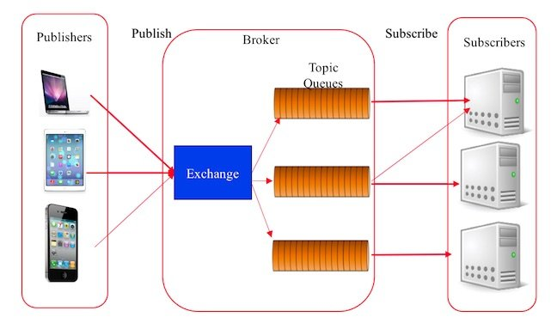
Architecture - AMQP
Notes:
AMQP is prettu simple to undersdtand.
There are clients apps that create/publish messages and deliver them to an AMQP broker.
The echange looks at the routing key and send every message to the correspondant queue.
When its time the messages arrive to the clients

Slide 7
Architecture – AMQP – Exchange
Is in charge of receiving the messages that have been sent by the producers and its responsible of place them in the proper queue according to a routing key.
This means that a producer sends the messages to an exchange not to a queue. Is the exchange who sends the messages to the queues depending on a routing key.
If a producer wants to send a message to more than one queue, the exchange is responsible for distributing this message to each one of the queues.

Slide 8
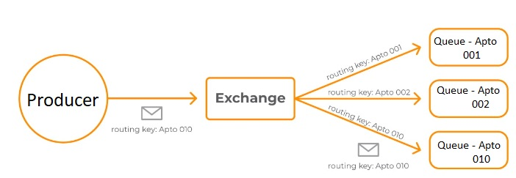
Architecture – AMQP – Exchange
Notes:
Direct exchange
Takes the routing key that comes inside the message and sends it to the queue that’s associated with this exchange and with this routing key.
The postman (producer) delivers the mail to the concierge (exchange) and that checks in which mailbox has to be placed the letter and places it.

Slide 9
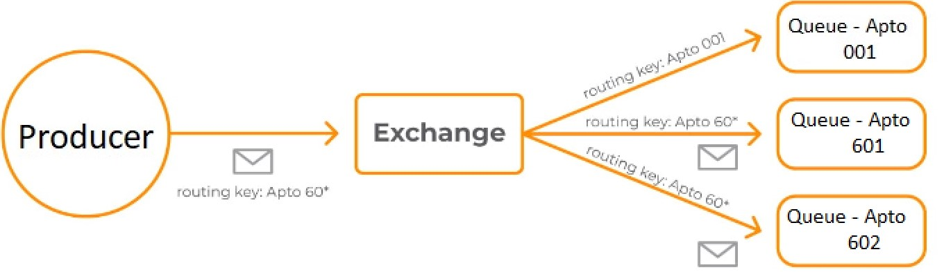
Architecture – AMQP – Exchange
Notes:
Topic exchange
Carries the message to the queues that complain with a pattern in the routing key.
The postman delivers to the concierge and that checks the pattern.

Slide 10
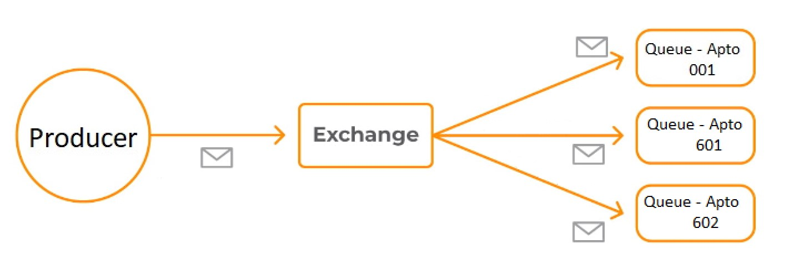
Architecture – AMQP – Exchange
Notes:
Fanout exchange
Sends the message to all the queues associated with the exchange, regardless of routing key

Slide 11
Architecture – AMQP – Routing key
Identifier that uses the exchange to know the route.
Identifier that uses a queue to know with which exchange is associated with.
Notes:
ID to know the route
ID to know to which exchange I’m associated with

Slide 12
Architecture – AMQP – Queue
Data structure that imitates real queues as the ones we can see in the mailbox.
A message queue is an asynchronous communication way that is used on microservices architectures.
The messages are stored in the queue until are received and deleted being every message processed only once.

Slide 13
Architecture – AMQP – Binding
Is a relationship between an exchange and a queue.
In an easy way: The queue is interested in messages from this exchange.
Bindings can take an extra routing key.
Channel.queue_bind(exchange = exchange_name, queue = queue_name, routing_key = ‘black’)
The fanout exchanges ignore the routing_key value.
Notes:
A bind is from which exchange messages a queue is interested.
The code is Pika python client.

Slide 14
Architecture – AMQP – Virtual host
VH refers to the practice of running more than one web site on a single machine.
RabbitMQ’s VH are very similar to the Apache’s.
The difference ➔ In Apache, VH are defined in the configuration file. In RabbitMQ are created and deleted using rabbitmqctl or HTTP API.
When an AMQP client connects to RabbitMQ, it specifies a VH name to connect to. If the username is not granted permissions, the connection is refused.
Notes:
VH is a practice of running more than 1 website in a single machine.
In apache VH are defined in the config’s file. In RabbitMQ we use rabbitmqctl or an HTTP API.
When an AMQP client connects to RabbitMQ specifies a VH name to connect to. If the user does not have permisions, the connexion is refused.

Slide 15
Applications
Some protocols are going to be seen.
These protocols are plug-ins.
RabbitMQ can work properly without this set of protocol, but cannot work without AMQP
Notes:
RabbitMQ can work properly without this set of protocols and if it can work means that are not mandatory, nevertheless, RabbitMQ cannot run without AMQP.

Slide 16
Applications - MQTT
Based on the TCP stack as the communication base.
Is a push messaging service with the pub-sub pattern.
In this type of infrastructures the clients they connect with a central broker.
To filter the messages that are sent to each client, the messages are arranged in topics hierarchically organized. A client can publish a message in a specific topic. Other clients can subscribe to this topic and the broker will send the subscribed messages.
The clients open a TCP/IP connection with the broker until the client ends it.
Notes:
Based on the TCP stack as the communication base.
Is a push messaging service with the pub-sub pattern.
In this type of infrastructures the clients they connect with a central broker.
To filter the messages that are sent to each client, the messages are arranged in topics hierarchically organized. A client can publish a message in a specific topic. Other clients can subscribe to this topic and the broker will send the subscribed messages.
The clients open a TCP/IP connection with the broker until the client ends it.

Slide 17
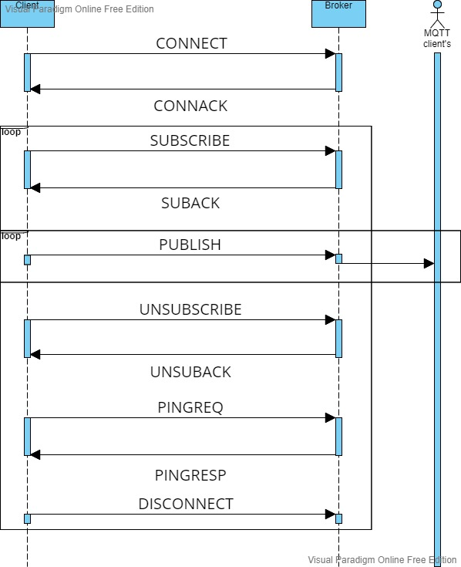
Applications - MQTT
Simple example of MQTT protocol through a SSD.

Slide 18
Applications - STOMP
“Simple Text Oriented Message Protocol”
Provides an interoperable wire format so that STOMP clients can communicate with any STOMP broker to provide easy messaging interoperability among many languages, platforms and brokers.
STOMP is a very simple and easy to implement protocol, coming from the HTTP school of design.
The server is hard to implement well.
Very easy to implement a client (in a couple of hours)
Notes:
“Simple Text Oriented Message Protocol”
Provides an interoperable wire format so that STOMP clients can communicate with any STOMP broker to provide easy messaging interoperability among many languages, platforms and brokers.
A STOMP client can be implemented in a couple of hours.

Slide 19
Applications - WebSockets
Is a communication protocol over a TCP connection.
WebSockets are designed to work over HTTP ports 443 and 80 as well as to support HTTP proxies and intermediaries thus making it compatible with HTTP.
Notes:
Is a communication protocol over a TCP connection.
WebSockets are designed to work over HTTP ports 443 and 80 as well as to support HTTP proxies and intermediaries thus making it compatible with HTTP.

Slide 20
Applications – RabbitMQ streams
The RabbitMQ streams protocol allows communicating with streams.
The RabbitMQ stream is a Java library to communicate with the RabbitMQ stream plug-in.
It allows creating and delete streams, as well as to publish and consume from these streams.
A stream is a sequence of elements from a source that supports data processing operations.
Sequence of elements: while collections are about data, streams are about computations.
Source: streams consume data from a providing source.
Notes:
The RabbitMQ streams protocol allows communicating with streams.
The RabbitMQ stream is a Java library to communicate with the RabbitMQ stream plug-in.
It allows creating and delete streams, as well as to publish and consume from these streams.
A stream is a sequence of elements from a source that supports data processing operations.
Sequence of elements: while collections are about data, streams are about computations.
Source: streams consume data from a providing source.

Slide 21
RabbitMQ in the market
This section has three parts:
Advantages of RabbitMQ
Disadvantages of RabbitMQ
Competition in the market

Slide 22
RabbitMQ in the market - Advantages
Decoupling in time and in space.
Integration of apps through messages and from various locations.
Reliability.
Several characteristics that guarantee the delivery of the messages.
Cluster creation.
Sometimes, RabbitMQ has to be able to process more than thousands of messages per second without impacting on the app’s performance. For this, RabbitMQ allows the creation of clusters to scale horizontally the solution
Security.
RabbitMQ uses the Transport Layer Security (TLS) protocol.
Is a cryptographic protocol that provides secure connections through a network
Available.
The queues can be replicated in several nodes of the cluster and in case of failure of a node the broker can keep receiving and sending messages.
Affordable: Completely free.
Fault-tolerance (next slide)
Notes:
Allows the integration of different applications through messages in an asynchronous way (decoupling in time) and from various locations (decoupling in space).
Reliability: Incorporates some characteristics that allow it to guarantee the delivery of the messages.
Provides storing when there’re no consumers.
Possibility that the consumer accepts the delivery of the message to make sure that it has been processed only once.
Allows the message to be requeued in case of failure.
Cluster creation:
Sometimes, RabbitMQ has to be able to process more than thousands of messages per second without impacting on the app’s performance. For this, RabbitMQ allows the creation of clusters to scale horizontally the solution
Security.
TLS.
TLS is a cryptographic protocol that provides secure connections through a network, commonly the Internet.
Available:
the queues can be replicated in several nodes of the cluster, providing the security that in case of failure of a node the broker can keep receiving messages of the producers and keep delivering them to the proper consumers

Slide 23
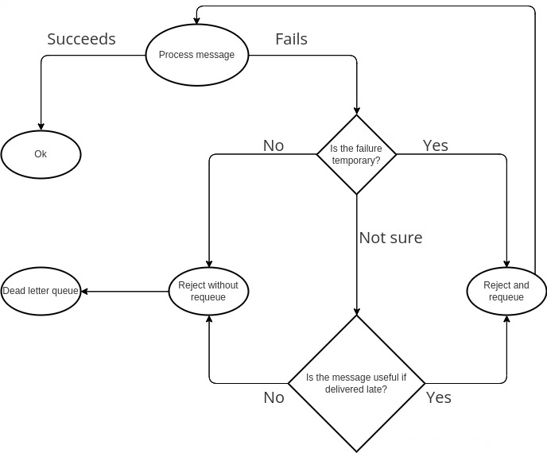
RabbitMQ in the market - Advantages

Slide 24
RabbitMQ in the market - Advantages
Complexity: RabbitMQ is user-friendly and it’s easy to modify the configurations to suit the expected porpoise.
Latency: Has the lowest latency of the market.
Performance: Has one of the best yields of the market
Notes:
Complexity: RabbitMQ is user-friendly and it’s easy to modify the configurations to suit the expected porpoise.
Latency: Has the lowest latency of the market.
Performance: Has one of the best yields of the market

Slide 25
RabbitMQ in the market - Disadvantages
Latency: The consumers will balloon in memory as they buffer all the messages in their own RAM.
A big buffer results in a lot of extra latency if the network performs normally
And huge amounts of extra latency if the client suddenly starts taking longer to process the messages.
Resource sharing: The management plug-in has to be enabled. ➔ By default the UI app will refuse to access to websites hosted on origins different from its own.
The AMQP need a certain processing capacity.
RabbitMQ is implemented in Erlang.
Notes:
Latency: The consumers will balloon in memory as they buffer all the messages in their own RAM.
A big buffer results in a lot of extra latency if the network performs normally
And huge amounts of extra latency if the client suddenly starts taking longer to process the messages.
Resource sharing: The management plug-in has to be enabled. ➔ By default the UI app will refuse to access to websites hosted on origins different from its own.
The AMQP need a certain processing capacity. ➔ Is not intended for its implementation in devices with limited computation resources and furthermore because of the quantity of control traffic that is introduced to offer reliability, is noit meant for its implementation in network with low bandwith.

Slide 26





RabbitMQ in the market – Competition in the market
Notes:
Kafka, Memphis, ActiveMQ, WSO2, ZeroMQ

Slide 27
Conclusions
RabbitMQ can support a lot of messaging protocols.
RabbitMQ is uncomplicated to use, reliable, scalable, available, secure, affordable, fault-tolerant and efficient.
There are many libraries available to implement it.
The exchange is a key element in a message-broker.
Many similarities between Apaches’ VH and RabbitMQ’s VH.
Every message has an “id” that makes it unique.
Is not perfect, but there are more advantages than disadvantages.
Has a lot of competition in the market, but is the most chosen.
Notes:
RabbitMQ can support a lot of messaging protocols.
RabbitMQ is uncomplicated to use, reliable, scalable, available, secure, affordable, fault-tolerant and efficient.
There are many libraries available to implement it.
The exchange is a key element in a message-broker.
Many similarities between Apaches’ VH and RabbitMQ’s VH.
Every message has an “id” that makes it unique.
Is not perfect, but there are more advantages than disadvantages.
Has a lot of competition in the market, but is the most chosen.

Slide 28
References
https://en.wikipedia.org/wiki/RabbitMQ
https://www.rabbitmq.com
https://www.sdos.es/blog/microservicios-mensajes-spring-rabbitmq
https://www.pragma.com.co/academia/lecciones/conozcamos-sobre-rabbitmq-sus-componentes-y-beneficios
https://www.researchgate.net/publication/325119432/figure/fig5/AS:626093459505153@1526283721309/AMQP-architecture-34.png
https://www.rabbitmq.com/protocols.html
https://www.rabbitmq.com/vhosts.html
https://www.luisllamas.es/que-es-mqtt-su-importancia-como-protocolo-iot/
https://en.wikipedia.org/wiki/WebSocket
http://stomp.github.io
https://programmerclick.com/article/80671335987/
https://blog.devgenius.io/scalable-system-implementation-using-rabbitmq-java-and-mysql-2d5fe0fa182e
https://blog.rabbitmq.com/posts/2012/05/some-queuing-theory-throughput-latency-and-bandwidth/
https://medium.com/codait/handling-failure-successfully-in-rabbitmq-22ffa982b60f
https://www.rabbitmq.com/management.html
https://geekflare.com/es/top-message-brokers/

